Slide 1
Unit Tests

Slide 2
Test-Driven Development (TDD)
Write Unit Tests based on requirement specifications
Write code (goal: turn all Unit Tests green)
Run Unit Tests: if any tests fail, go to 2
Refactor code. Goals:
Increase code quality (?)
Keep all Unit Tests green

Slide 3
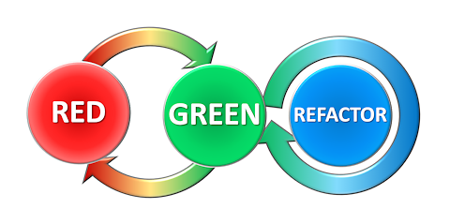

Slide 4
Unit Test Structure
ARRANGE: Create scenario for this specific test
ACT: Perform the test (e.g. a single method call)
ASSERT: Compare expected and actual result of the test
SUCCESS
FAIL

Slide 5
Unit Test project
Add to same solution as project under test
Type of project is MSTest Test Project
Name: up to you ☺. E.g. UnitTestProject

Slide 6
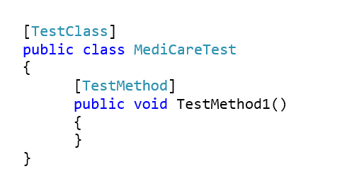

Slide 7
”This class contains Unit Test methods”
”This method is a Unit Test method”

Slide 8
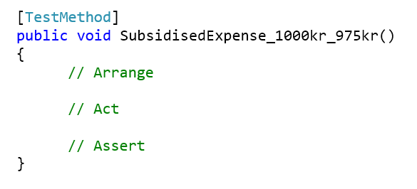

Slide 9
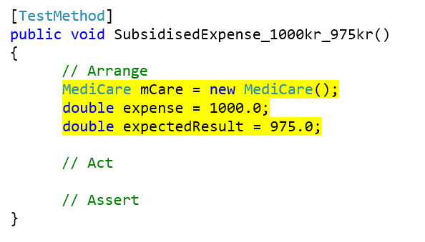

Slide 10
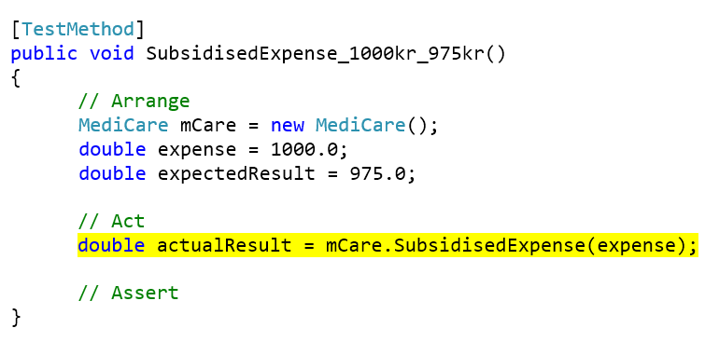

Slide 11
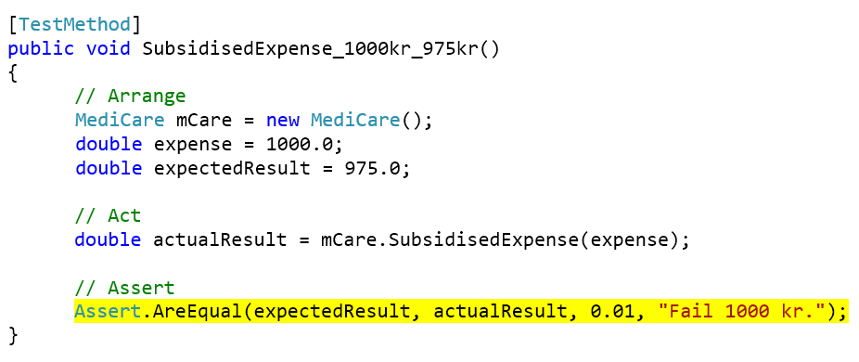

Slide 12
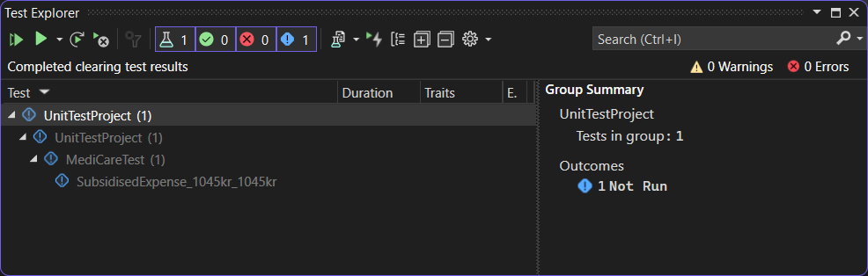

Slide 13
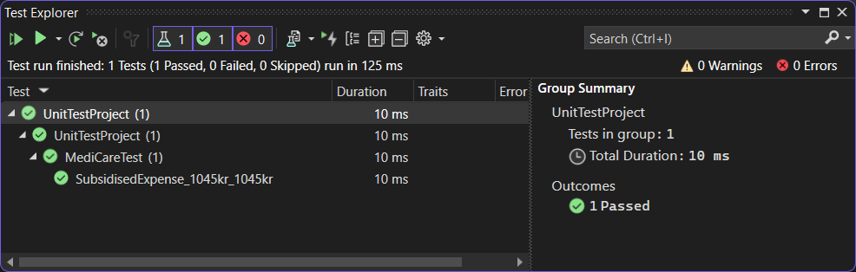

Slide 14
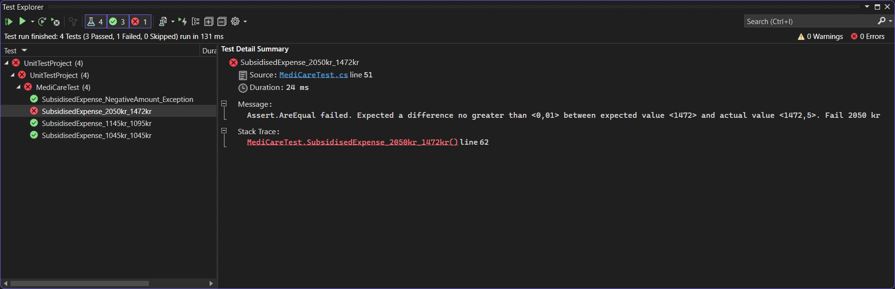

Slide 15
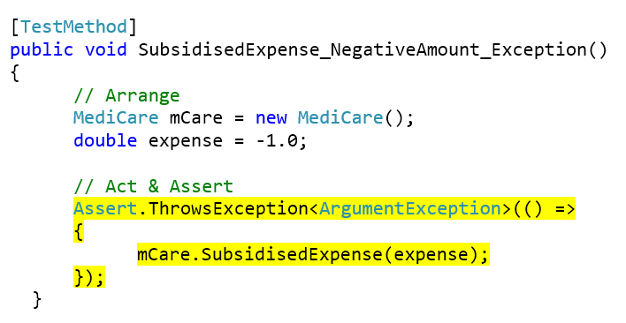

Slide 16
Live Unit Testing
Runs in the background while you write code
Real-time feedback
Enable by choosing Test | Live Unit Testing | Start

Slide 17
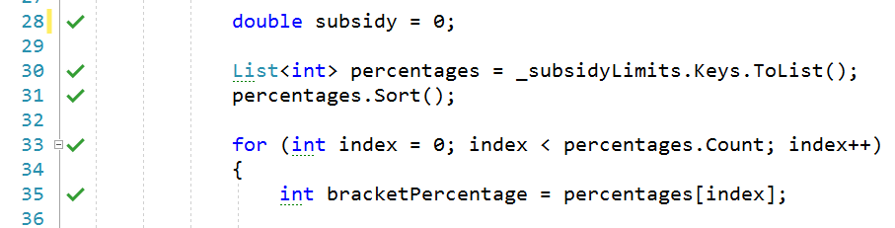

Slide 18
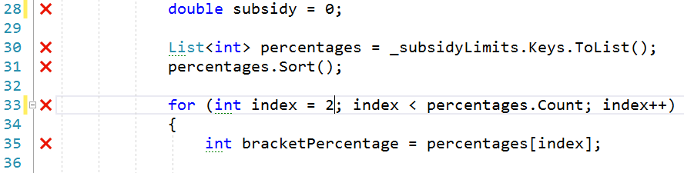

Slide 19
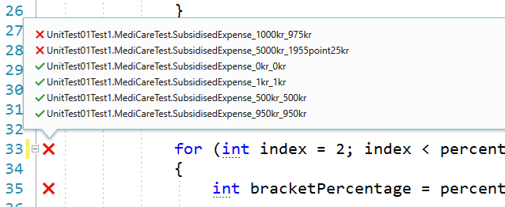

Slide 20
Code coverage
Are all parts of the code ”touched” by the Unit Test?
All lines of code should be covered by at least one Unit Test case
Start code coverage analysis by choosing Test | Analyze Code Coverage for All Tests

Slide 21
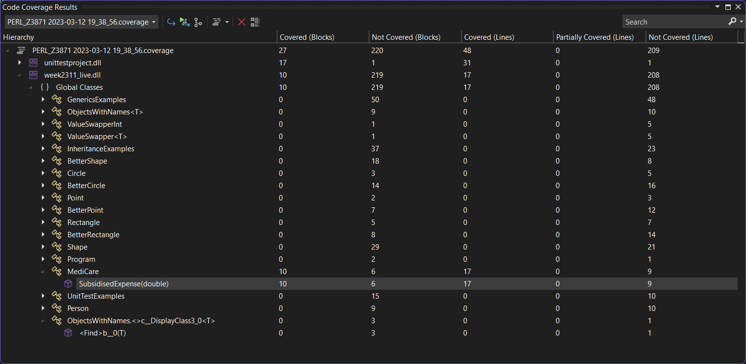

Slide 22
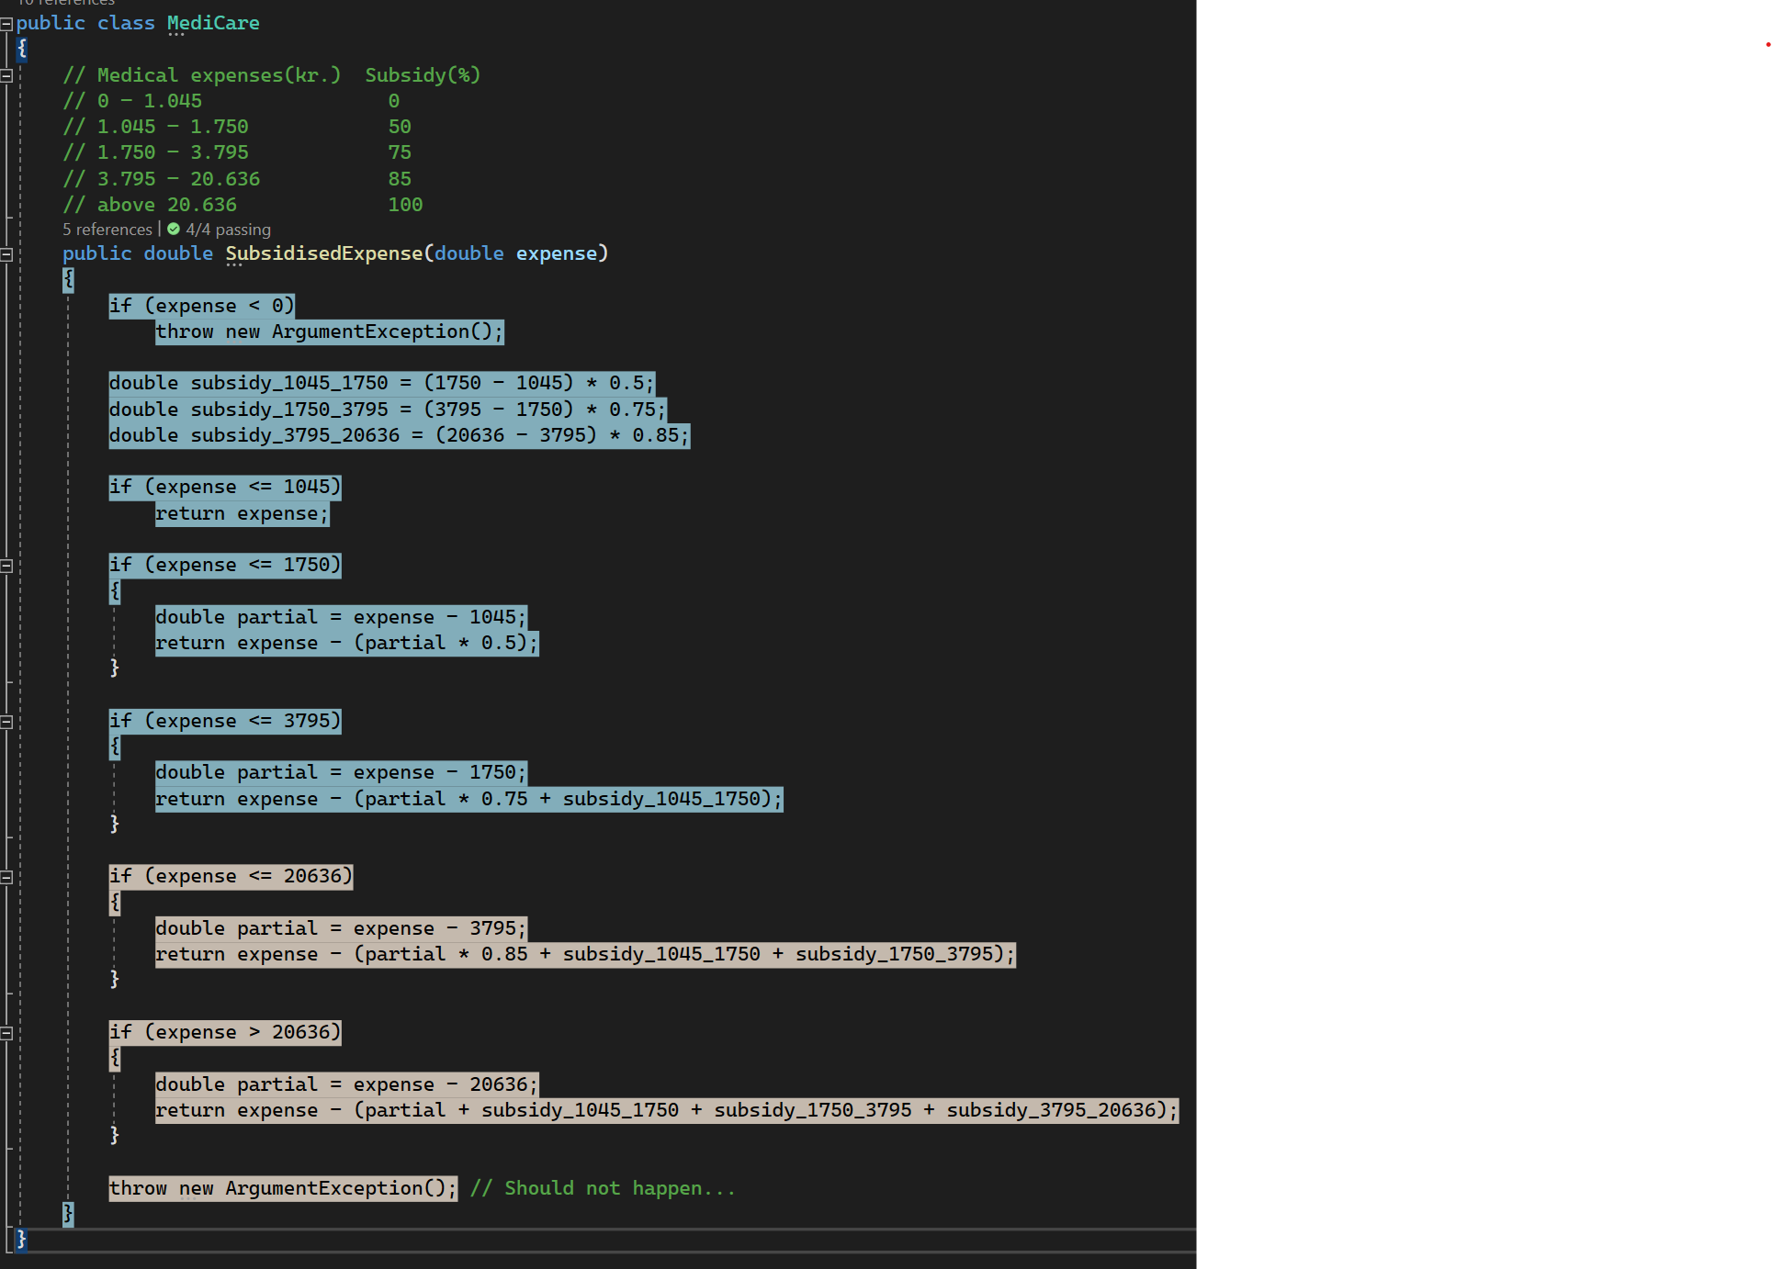

Slide 23


Slide 24
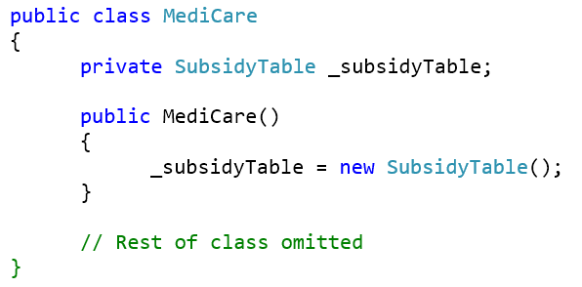

Slide 25
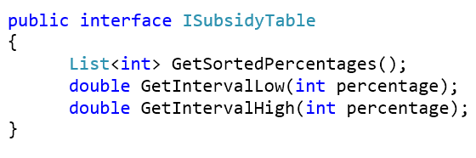

Slide 26
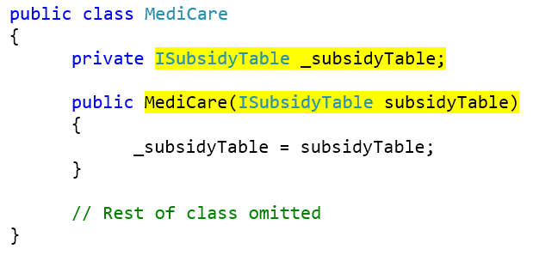

Slide 27
